Slide 1
Learn.Do.Now.
wdt.edu

Slide 2
Scholarships Application & Essay Tips
wdt.edu

Slide 3
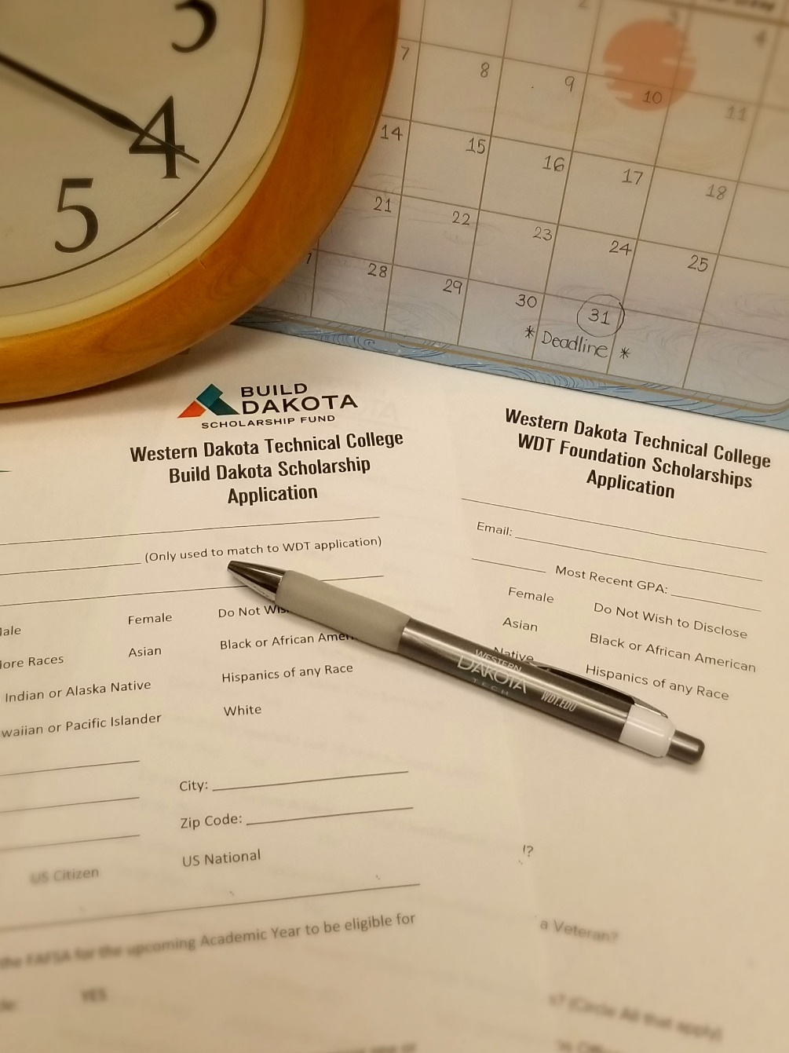
General Scholarship Application Tips
Meet the Deadlines.
Plan Ahead.
Use a Professional Email Address.
Oops.oppsy.haha@email.address
First.lastname@email.address
Last.firstname_number@email.address
Pay Attention to Details & Directions.
Submit All Required Documents.
Good idea to submit “optional" documents such as a letter of recommendation.
wdt.edu

Slide 4
General Scholarship Application Tips
Write a Great Essay.
*PROOFREAD.*
Review the Application One Last Time Before Submitting.
Check your email often.
Also check your spam folder.
Most Scholarships are not a One-Time Deal.
wdt.edu

Slide 5
General Scholarship Application Tips
Do NOT Pay to Apply for Scholarships*.
Scholarships give you free money, NOT take your money!
*Some professional organizations require scholarship recipients to be a member of the scholarship granting organization to qualify. These fees are different than paying to apply but may be required for scholarship eligibility. Never put your credit card or bank information into a scholarship application.
Beware of Scholarship Scams.
“You’ve been pre-selected.”
“You're a finalist [for a scholarship you never applied].”
“This scholarship is guaranteed or your money back.”
“We'll do all the work. You just pay a processing fee.”
For more information about scholarship scams: https://consumer.ftc.gov/articles/how-avoid-scholarship-financial-aid-scams
https://finaid.org/scholarships/scams/
wdt.edu

Slide 6
Why Do Scholarships Require Essay?
Most scholarships require an essay as a way to get to know you, your value, and your motivations.
Are There No-Essay Scholarships?
Yes, they are some out there. You will need to do your research.
Scholarship Essay Facts
wdt.edu

Slide 7
Scholarship Essay Tips
Planning
Start early.
Read the instructions.
Understand the essay prompts/questions.
Know the word limit.
Brainstorm your thoughts.
Outline your essay.
Writing
Be honest.
Be original.
Be professional.
Be specific & concise.
Use “show, don’t tell.”
Be positive & inspirational.
Sell yourself but also be humble.
Editing
Check grammar and spelling.
Read your essay out loud.
Proofread your own essay.
Ask someone else to look it over.
Save your essay!!
wdt.edu

Slide 8
Scholarship Essay Tips
Additional Resources:
Essay Outline:
Introduction – An opening paragraph that states the purpose and outlines the main objectives of an essay.
A way to convince the scholarship scorers to read your essay. “Read Me, Please!”
Body – The main paragraph(s) to answer the scholarship prompt/questions and sell yourself.
“Show, Don’t Tell.”
Details & Action.
Discuss one central point in each paragraph.
Conclusion – The last paragraph to wrap up your essay.
The ending that the scholarship scorers to remember you.
Avoid “In conclusion,…” or “In short,…”
What’s the Right Scholarship Essay Format & Structure.
(https://www.goingmerry.com/blog/scholarship-essay-format/)
Essay Writing – Outlines.
(https://natureofwriting.com/courses/essay-writing/lessons/the-writing-process/topic/outlines/)
Use This Scholarship Essay [w/example].
(https://scholarshipowl.com/blog/apply-for-scholarships/use-this-scholarship-essay-format/)
wdt.edu

Slide 9
Scholarship Essay Tips
Additional Resources:
Brainstorming:
Brainstorm Common Scholarship Essay Questions.
(https://www.fastweb.com/college-scholarships/articles/brainstorm-common-scholarship-essay-questions)
Essay Writing – Brainstorming Strategies.
(https://natureofwriting.com/courses/essay-writing/lessons/the-writing-process/topic/brainstorming-strategies/)
Essay Planning & Writing Process Handouts from San Jose State University Writing Center.
(https://www.sjsu.edu/writingcenter/resources/handouts/ )
wdt.edu

Slide 10
Scholarship Essay Tips
Additional Resources:
Show, Don’t Tell:
4 Ways to Show (Not Tell) in Your Personal Statement.
(http://theadmissionsguru.com/blog/personal-statement-examples-show-not-tell)
How to “Show, Don’t Tell” in College Essay.
(https://www.collegeessayguy.com/blog/show-dont-tell)
6 Tips to Show Instead of Tell.
(https://blog.reedsy.com/show-dont-tell/)
wdt.edu

Slide 11
Scholarship Essay Tips
Your essay is the best way to make yourself stand out from others!
Additional Resources:
Essay Prompts/Questions:
What is an Essay Prompt?
(https://www.scholarshipsinink.com/scholarship-essays/what-is-an-essay-prompt)
Top 10 Scholarship Essay Prompts.
(https://www.goingmerry.com/blog/common-scholarship-essay-prompts/)
Common Questions:
Tell us about yourself.
How did you decide on your chosen program of study? Why are you interested in the career field you have chosen?
What are your career goals?
What is your greatest strength?
Describe a challenge you faced/have faced and steps you that help you overcome it.
Why are you the best candidate for this scholarship?
wdt.edu

Slide 12
Scholarship Essay Tips
Additional Resources:
Essay writing:
Writing Winning Scholarship Essays.
(https://libraryguides.mdc.edu/c.php?g=401717&p=2971022)
Top 10 Tips for Writing Effective Scholarship Essays.
(https://www.scholarships.com/financial-aid/college-scholarships/scholarship-application-strategies/top-10-tips-for-writing-effective-scholarship-essays/)
How to Write a Scholarship Essay & Win BIG [2022 Edition].
(https://myscholly.com/how-to-write-a-scholarship-essay/)
How to Write a Scholarship Essay.
(https://bold.org/blog/how-to-write-a-scholarship-essay/#step12)
Writing the Essay Scholarship Essay.
(https://finaid.med.ufl.edu/scholarships/writing-the-scholarship-essay/)
wdt.edu

Slide 13
Scholarship Essay Tips
Additional Resources:
Proofread:
How to Effectively Edit & Proofread Your Own Work.
(https://www.universalclass.com/articles/writing/effectively-copyedit-and-proofread-your-own-work.htm)
Grammarly.
(Grammarly: Free Online Writing Assistant) – Free version works great.
How to Proofread Your Own Writing.
(https://denisecowleeditorial.com/how-to-proofread-your-own-writing/)
How to Proofread an Essay.
(https://examstudyexpert.com/how-to-proofread-an-essay/)
Proofread – Where Do I Begin?
(https://owl.purdue.edu/owl/general_writing/the_writing_process/proofreading/)
wdt.edu

Slide 14
Scholarship Resume Tips
Resources:
Resume – A document that lists your experience & Qualifications.
Not all scholarships require a resume. But you may get a bonus point to submit one.
Difference Between a Scholarship Resume & a Work Resume.
(https://www.scholarshipsinink.com/difference-between-a-scholarship-resume-and-a-work-resume/)
The Importance of Scholarship Resumes.
(http://www.gocollege.com/financial-aid/scholarships/apply/resume.html)
Guide to Writing a Scholarship Resume from College of Southern Nevada.
(guide_to_writing_scholarship_resume.pdf (csn.edu))
Guide to Writing a Scholarship Resume.
(https://www.indeed.com/career-advice/resumes-cover-letters/college-scholarship-resume)
Scholarship Resume Writing Tips.
(https://www.monster.com/career-advice/article/scholarship-resume)
wdt.edu

Slide 15
Recommendation Letter Tips
Tips:
Recommendation Letter – A letter from any person, who is not related to you and knows you well.
Ask the person politely & make sure you ask them before submitting their name.
Provide them with an adequate time to write.
Give them as much information as possible.
Your correct contact information.
A list of your extracurricular activities, class projects, etc.
Provide your resume if you have it.
The full title, description, and missions of the scholarship.
Make sure you thank them.
If you are a WDTC student, make sure you submit a “Reference Authorization” form to the Registrar Office. (https://www.wdt.edu/assets/docs/uploads/current-students/ferpa-forms/reference-authorization-form.pdf)
wdt.edu

Slide 16
Maintain GPA of 2.5 or higher.
Full-Time Enrollment.
3 Year Work Commitment.
January 1-March 31.
Covers tuition, fees, books, laptop, and any direct expenses required by the program.
Apply at https://my.wdt.edu/ICS/Scholarship
FULL-RIDE SCHOLARSHIP
wdt.edu

Slide 17
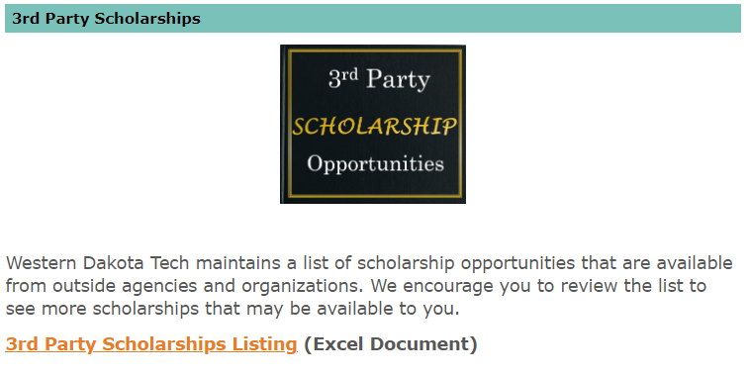
More Scholarship Opportunities at WDTC
WDT Foundation Scholarships
3rd Party Scholarship Listing
31
Apply at https://my.wdt.edu/ICS/Scholarship
wdt.edu

Slide 18
WDT Foundation Scholarship
Applications Open
January 1-March 31
August 1-October 31
$ Scholarship Workshops
$$ Appointments for 1 on 1 Assistance
$$$ WDTScholarship@wdt.edu or
605.718.3064
wdt.edu

Slide 19
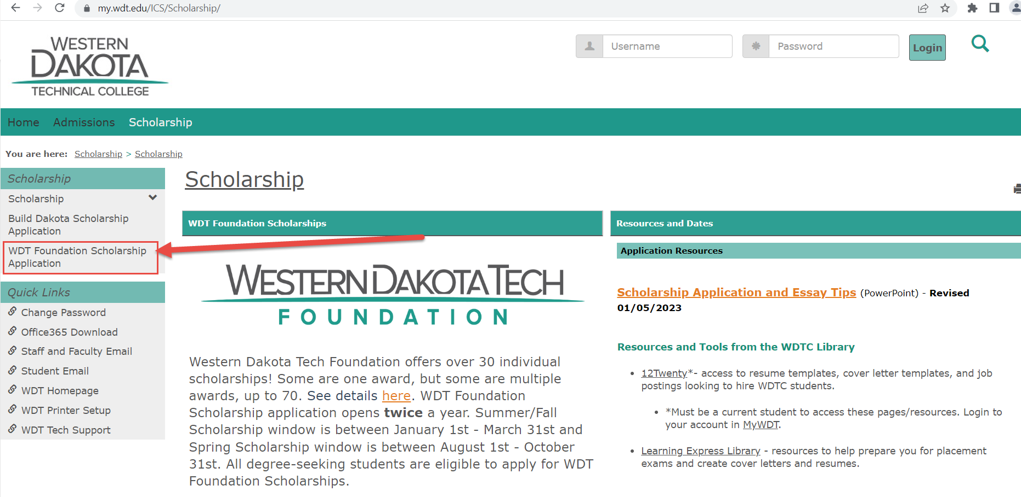
Applying for Scholarships is FREE! Located in MyWDT.
wdt.edu

Slide 20
You do not have to be accepted into WDTC before applying for Build Dakota Scholarship & WDT Foundation Scholarships, but you do need to have applied to the college to receive a “student ID number.” Then, you can start the scholarship application. Free to Apply to WDTC at https://wdt-applynow.force.com/apply/
wdt.edu

Slide 21
At your service…
Chutima Supboon
Scholarship Outreach Specialist
WDTScholarship@wdt.edu
Phone: 605.718.3064
Office: Enrollment Services
Andrew Kapelewski
Assistant Director of Scholarships
WDTScholarship@wdt.edu
Phone: 605.718.3061
Office: Enrollment Services
wdt.edu

Slide 22
Learn.Do.Now.
Questions?
wdt.edu

