Slide 1
Learn.Do.Now.
Scholarship Info & Assistance Session
wdt.edu

Slide 2
Agenda:
Build Dakota Scholarship
Scholarship Details
How to Apply
WDT Foundation Scholarships
Scholarship Details
How to apply
Scholarship tips
wdt.edu

Slide 3
WDT Foundation Scholarships:
Over 30 individual scholarships from one award up to 70 awards.
Over $500,000 awarded annually.
Based on merit, financial need, and career goals
Universal scholarship application.
One application that will automatically applies the applicants to every foundation scholarship they are eligible!
How to Apply:
January 1 – March 31 for Summer/Fall.
August 1 – October 31 for Spring.
https://my.wdt.edu/ics/scholarship/
Requires a student ID # to submit the scholarship application.
2 Essay questions.
No minimum GPA to apply!
No age limit!
wdt.edu

Slide 4
Universal Application for all WDT Foundation Scholarships!
Summer/Fall WDT Foundation Scholarships
Alen Sigman Memorial - $250
Betty Sever - $300
Black Hills Metal Fabricators - $1,000
Bridges Scholarships - $1,000
Brosz Engineering - $1,000
Building Community - $1,000
Caterpillar MineStar – Full-ride scholarship for Autonomous Equipment Technician Program
Craig & Joan Uhre - $1,000
Crazy Horse Memorial - $500 to $2,000 (multiple awards)
Dr. Ann Bolman Memorial – $500
Dr. Kenneth Gifford Memorial - $1,000 (multiple awards)
eCampus Textbook Scholarship – Varies (multiple awards)
EE Diers Family Scholarship - $500 - $3,000 (multiple awards)
Independent Insurance Agents of Rapid City - $500 (multiple awards)
John T. Vucurevich Foundation - $1,500 to $2,500 (multiple awards)
Laverne & Myrtle Eich - $10,000 (multiple awards)
Milton DeBrie Memorial - $500
Montana Dakota Utilities - $1,250 (multiple awards)
Myron Matusiak Memorial - $1,000
Northern Hills DAV - $1,000 (multiple awards)
PhleBiz - $200 - $2,000 (multiple awards)
Robbie Ludeman Memorial - $250
RSES Scholarship - $500
SD Education Access Foundation - $1,000 -$2,000 (multiple awards)
Universal Pediatrics LPN-RN - $1,000 (multiple awards)
WDTC Alumni Paying It Forward Scholarship - $250 (multiple awards)
William J. Pierce Memorial - $250
wdt.edu

Slide 5
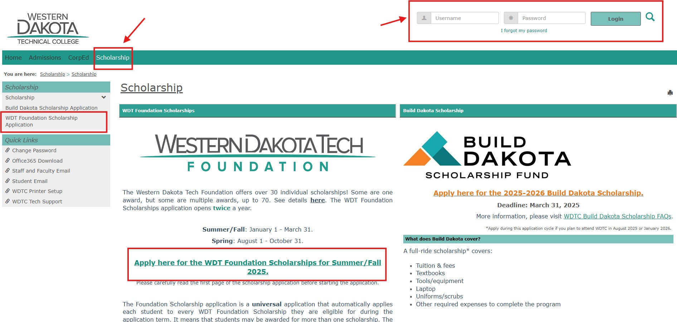
Applying for Scholarships is FREE! Located in MyWDT.
wdt.edu

Slide 6
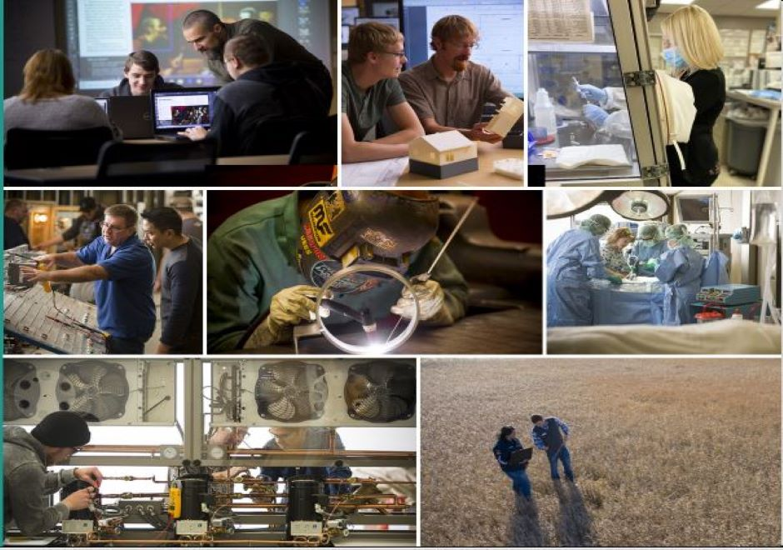
Build Dakota Scholarship award varies between $15,000 - $35,000.
Covers: Tuition, fees, books, laptop, tools/equipment, uniforms.
No minimum GPA to apply!
No age limit but must have HS diploma/GED.
20+ eligible programs at WDTC!
1-year Diploma & 2-year AAS
FULL RIDE SCHOLARSHIP
wdt.edu

Slide 7
High Need Fields of Study
Architectural & Engineering Technology (AAS)
Automotive Technology (AAS)
Computer Science/IT Specialist (AAS)
Construction Technology (Diploma)
Dental Assisting (Diploma)
Diesel Technology (AAS)
Drafting & Machining Technology (AAS)
Electrical Trades (AAS)
Environmental Engineering Technician (AAS)
Health Information Management – Coding Specialty (AAS)
HVAC/Refrigeration Technology (AAS)
Law Enforcement Technology (AAS)
Medical Laboratory Technician (AAS)
Paramedic (AAS)
Plumbing Technology (Diploma)
Practical Nursing (Diploma)
Precision Machining Technology (Diploma)
Radiologic Technology (AAS)
Registered Nursing (AAS)
Surgical Technology (AAS)
Welding & Fabrication (AAS)
Welding & Fabrication (AAS & Diploma)
Agriculture
Automotive/Diesel
Building Trades/Construction
Energy Technicians
Engineering Technicians
Healthcare & Public Safety
IT/Computer Information Systems
Precision Manufacturing
Welding
wdt.edu

Slide 8
Recipient’s Commitment:
Full-time student at Western Dakota Technical College.
Maintain 2.5 GPA or higher.
Excellent attendance, behavior, and communication.
Work full-time in the field of study for 3 year in South Dakota
How to Apply:
January 1 – March 31.
https://my.wdt.edu/ics/scholarship/
Essay questions.
Optional: Resume & Letter of Recommendation.
No minimum GPA to apply!
No age limit!
Must have a HS diploma/GED.
FULL IDE SCHOLARSHIP
Debt Conversion
wdt.edu

Slide 9
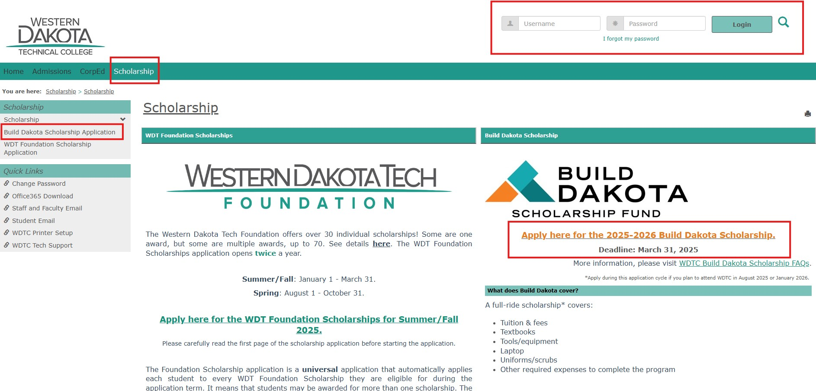
Applying for Build Dakota Scholarship is FREE! Located in MyWDT.
wdt.edu

Slide 10
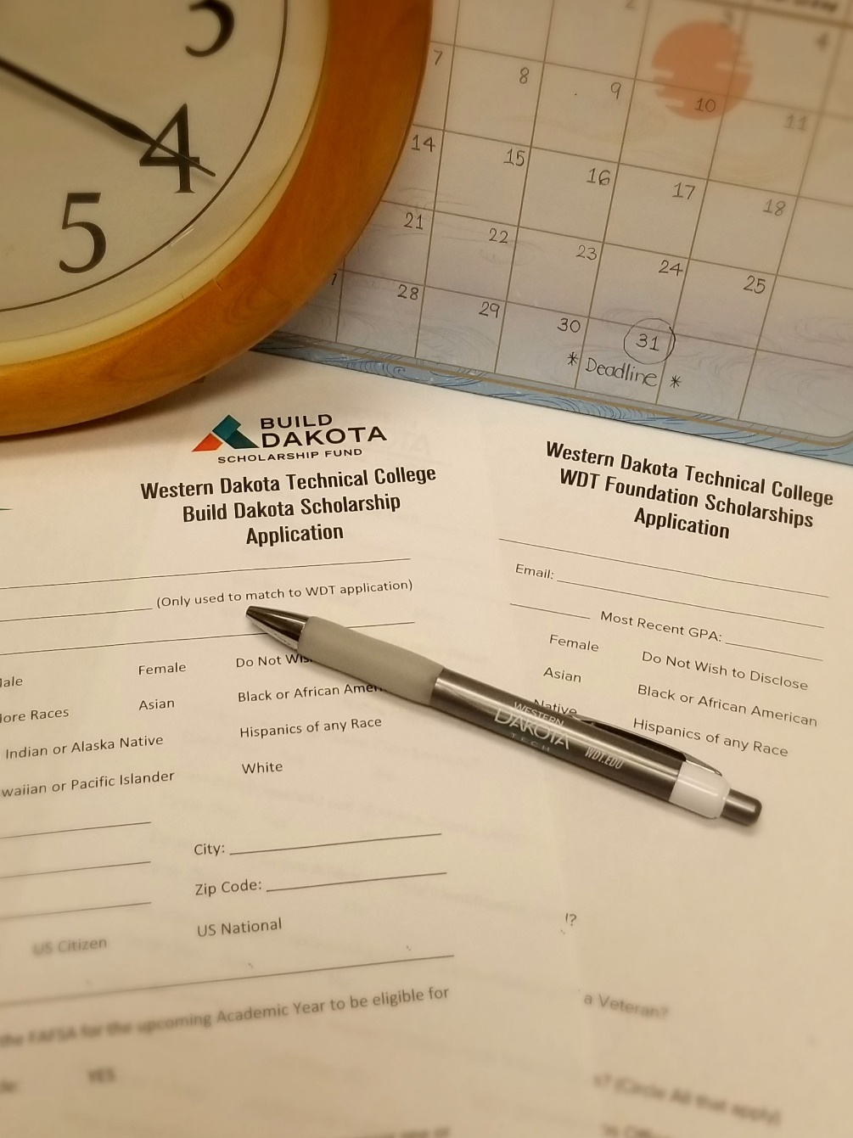
General Scholarship Application Tips
Pay Attention to Instructions, Requirements, Eligibilities, Details & Directions.
Plan Ahead & Meet the Deadlines.
Use a Professional Email Address**.
Funnyhaha.bro@email.address.com
First.lastname@email.addresss.com
Last.firstname_number@email.address.com
**use an email that you have an access at all time!
Submit All Required Documents.
Good idea to submit “optional" documents such as a letter of recommendation.
wdt.edu

Slide 11
Scholarship Essay Tips
Planning
Start early.
Read the instructions.
Understand the essay prompts/questions.
Know the word limit.
Brainstorm your thoughts.
Outline your essay.
Writing
Be honest.
Be original.
Be professional.
Be specific & concise.
Use “show, don’t tell.”
Be positive & inspirational.
Sell yourself but also be humble.
Editing
Check grammar and spelling.
Read your essay out loud.
Proofread your own essay.
Ask someone else to look it over!
Save your essay!!
Editing Tool & Resource
Grammarly (free version)
Purdue Online Writing Lab (OWL)
wdt.edu

Slide 12
Scholarship Essay Prompts
Why do you choose this career field?
Reflect on the personal experience or moment that led to this career choice & connect them to your passion.
Be specific—describe the path and the impact it had on your decision.
Explain how you plan to contribute to the field after graduation.
Describe a challenge & how you overcame it.
Focus on a specific instance.
Focus on growth and lessons learned.
Highlight transferable skills.
Be original.
Be positive & inspirational.
Why are you the best candidate for this scholarship?
Demonstrate commitment, passion, and work ethic.
What set you apart from others?
Emphasize unique qualities and career-relevant strengths.
wdt.edu

Slide 13
Need Help With Scholarship Application
Contact the WDTC Scholarship Office:
WDTScholarship@wdt.edu
605-718-3064 or 605-718-3061
One-on-One Appointment:
Monday – Friday
9:30 a.m. – 5 p.m.
Time doesn’t work out – Reach out to us.
wdt.edu

Slide 14
THANK YOU!
wdt.edu
Notes:
Welcome

