Slide 1


Generating resources for Western Dakota Technical College in support of students and workforce development.
Scholarship Information & Essay Tips
wdt.edu/wdtf

Slide 2



Agenda:
Build Dakota Scholarship
  Scholarship Details
  How to Apply
WDT Foundation Scholarships
  Scholarship Details
  How to apply
Scholarship tips
wdt.edu/wdtf

Slide 3

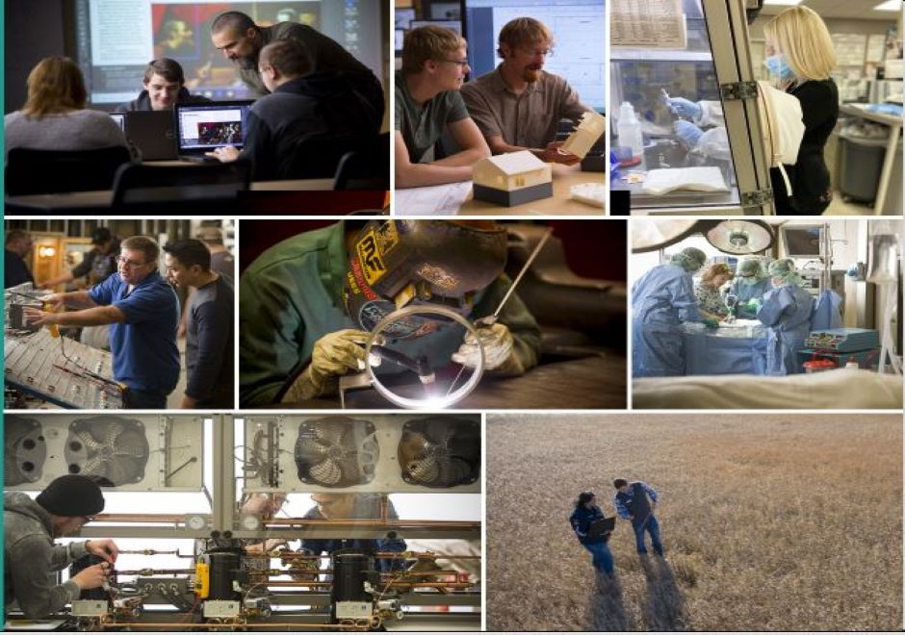
Build Dakota Scholarship award varies between $15,000 - $30,000.
Covers: Tuition, fees, books, laptop, tools/equipment, uniforms.
No minimum GPA to apply!
Over 20 eligible programs at WDTC!
  1-year Diploma & 2-year AAS
FULL RIDE SCHOLARSHIP
wdt.edu/wdtf

Slide 4

High Need Fields of Study
Architectural & Engineering Technology (AAS)
Automotive Technology (AAS)
Computer Science/IT Specialist (AAS)
Construction Technology (Diploma)
Diesel Technology (AAS)
Electrical Trades (AAS)
Environmental Engineering Technician (AAS)
Health Information Management – Coding Specialty (AAS)
HVAC/Refrigeration Technology (AAS)
Law Enforcement Technology (AAS)
Machining & Engineering Technology (AAS)
Medical Laboratory Technician (AAS)
Paramedic (AAS)
Plumbing Technology (Diploma)
Practical Nursing (Diploma)
Precision Machining Technology (Diploma)
Registered Dental Assisting (Diploma)
Registered Nursing (AAS)
Surgical Technology (AAS)
Welding & Fabrication (AAS & Diploma)
Automotive/Diesel
Building Trades/Construction
Energy Technicians
Engineering Technicians
Healthcare & Public Safety
IT/Computer Information Systems
Precision Manufacturing
Welding
wdt.edu/wdtf

Slide 5

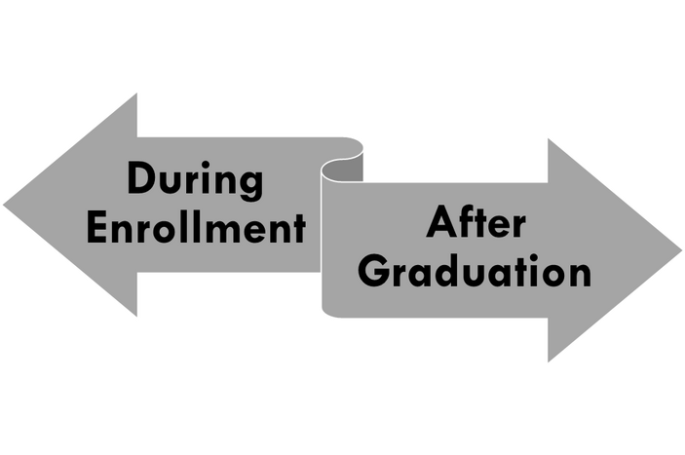
How to Apply:
January 1 – March 31.
https://my.wdt.edu/ics/scholarship/
Essay questions.
Optional: Resume & Letter of Recommendation.
No minimum GPA to apply!
No age limit!
Recipient’s Commitments:
Full-time student at Western Dakota Technical College.
Maintain 2.5 GPA or higher.
Excellent attendance, behavior, and communication.
Work full-time in the field of study for 3 years in South Dakota
Debt Conversion
wdt.edu/wdtf

Slide 6

WDT Foundation Scholarships:
Over 30 individual scholarships from one award up to 70 awards.
Over $500,000 awarded annually.
Universal scholarship application.
  One application that will automatically applies the applicants to every foundation scholarship they are eligible!
How to Apply:
January 1 – March 31 for Summer/Fall.
August 1 – October 31 for Spring.
https://my.wdt.edu/ics/scholarship/
Requires a student ID # to submit the scholarship application.
2 Essay questions.
No minimum GPA to apply!
No age limit!
wdt.edu/wdtf

Slide 7
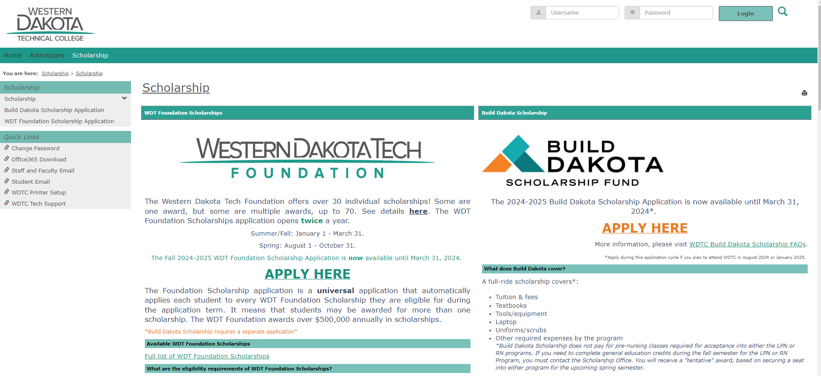
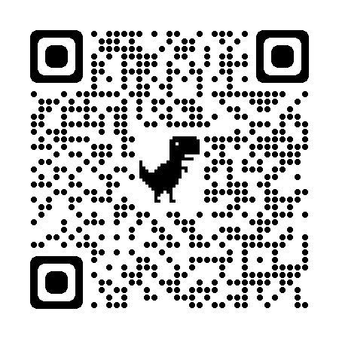
https://my.WDT.edu/ICS/Scholarship/
wdt.edu/wdtf

Slide 8
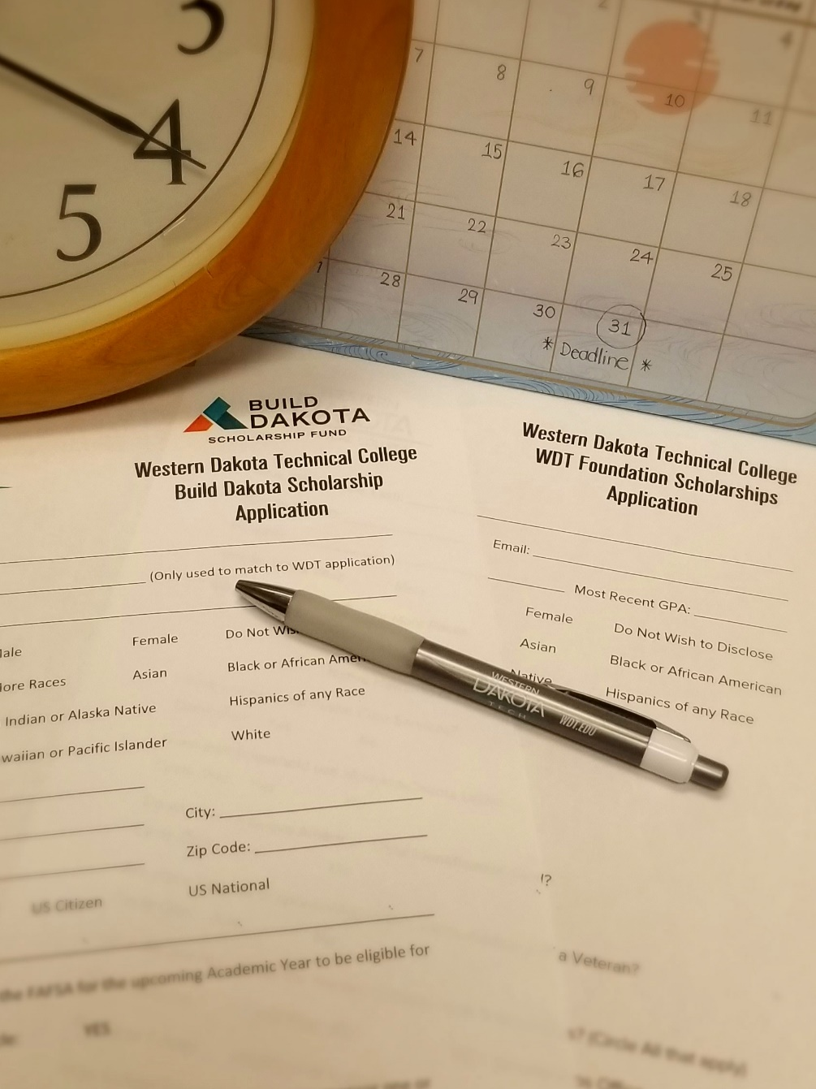


General Scholarship Application Tips
Pay Attention to Instructions, Requirements, Eligibilities, Details & Directions.
Plan Ahead & Meet the Deadlines.
Use a Professional Email Address**.
  Hotrod.bro.420@email.address.com
  First.lastname@email.addresss.com
  Last.firstname_number@email.address.com
  **use an email that you can access at all time!
Submit All Required Documents.
  Good idea to submit “optional" documents such as a letter of recommendation.
wdt.edu/wdtf

Slide 9
WDT Scholarship Application Tips
Pay Attention to Instructions, Requirements, Eligibilities, Details & Directions.
Plan Ahead & Meet the Deadlines.
Use your WDTC Student Email Address.
wdt.edu/wdtf

Slide 10
General Scholarship Application Tips
Write a Great Essay.
*PROOFREAD.*
Review the Application One Last Time Before Submitting.
Check your email often.
  Also check your spam folder.
Most Scholarships are not a One-Time Deal.
wdt.edu/wdtf

Slide 11


Scholarship Essay Tips
Planning
  Start early.
  Read the instructions.
  Understand the essay prompts/questions.
  Know the word limit.
  Brainstorm your thoughts.
  Outline your essay.
Writing
  Be honest.
  Be original.
  Be professional.
  Be specific & concise.
  Use “show, don’t tell.”
  Be positive & inspirational.
  Sell yourself but also be humble.
Editing
  Check grammar and spelling.
  Read your essay out loud.
  Proofread your own essay.
  Ask someone else to look it over!
  Save your essay!!
Editing Tool & Resource
Grammarly (free version)
Purdue Online Writing Lab (OWL)
wdt.edu/wdtf

Slide 12
Scholarship Essay Tips
Essay Outline:
  Introduction – An opening paragraph that states the purpose and outlines the main objectives of an essay.
      A way to convince the scholarship scorers to read your essay. “Read Me, Please!”
  Body – The main paragraph(s) to answer the scholarship prompt/questions and sell yourself.
      “Show, Don’t Tell.”
        Details & Action.
      Discuss one central point in each paragraph.
  Conclusion – The last paragraph to wrap up your essay.
      The ending that the scholarship scorers to remember you.
      Avoid “In conclusion,…” or “In short,…”
wdt.edu/wdtf

Slide 13
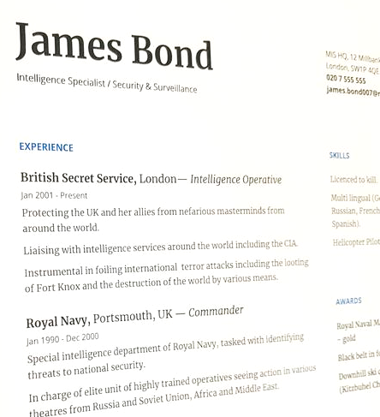
Scholarship Resume & Recommendation Letter
Resume - A document that lists your experience & Qualifications.
  Include the basics: name, contact information, educations, volunteer experiences, honors, awards, and achievements.
  One page – clear & concise to spark interest to want to know more about you!
Recommendation Letter - A letter from any person, who is not related to you and knows you well.
  Ask them before submitting their names.
  Provide them with an adequate time to write.
  Give them as much information as possible.
    The full title, description, and missions of the scholarship.
    Your correct contact information.
wdt.edu/wdtf

Slide 14


Need Help With Scholarship Application
Contact the WDT Foundation:
          Foundation@wdt.edu
          605-718-1030
          Monday – Friday
          9:30 a.m. – 5 p.m.
            Time doesn’t work out – Reach out to us.
WDTC location: 800 Mickelson Drive, Rapid City, SD 57703
wdt.edu/wdtf

Slide 15

THANK YOU!
wdt.edu
Notes:
Welcome

